Slide 1





The Pesticide Properties Database
And its sister databases on biopesticides and veterinary substances
August 2025

Slide 2
Table of contents
01 Introduction & aims
02 Data content
03 System formats
04 Data sources & data management
05 BPDB, VSDB & other substances
06 User support facilities
07 Hints & tips
08 Licensing, T&Cs & services
09 Example applications
10 Contact details

Slide 3
Introduction
01
The Pesticide Properties DataBase (PPDB) is a relational database and information system designed to support pesticide risk activities. It includes a comprehensive range of usage, regulatory, physico-chemical, environmental fate, ecotoxicological and human health data for a large number of synthetic pesticides.
A related system – the Biopesticide Properties DataBase (BPDB) – holds similar data for biopesticides which includes plant- and insect-derived chemicals, semio-chemicals, beneficial viruses and bacteria, as well as micro- and macro-organisms.
There are two other related data sets. Firstly, the Veterinary Substance DataBase (VSDB) holds similar data to the PPDB and BPDB for substances used in veterinary medicine. Secondly, our dataset on ‘Other related substances’ includes data for biostimulants, synergists and safeners, adjuvants, wood preservatives, bactericides and other biocides.
All four datasets have a similar structure and presentation format. They share the same website and user facilities. This presentation focuses on the PPDB but will also briefly describe the data differences.

Slide 4
PPDB history
The PPDB began in 1994 as part of a research project to develop an environmental management system for agriculture (EMA). EMA was released as a CD-ROM and included a simple database of pesticide properties to support the pesticide risk module within it.
Over time, due to requests to share, the database grew in terms of the number of active substances it contained data for, and the range of parameters stored. Eventually, EMA was retired but certain aspects, including the pesticide database, were retained and moved on-line.
This opened up the database globally and significant demand coupled with the ever more demand for data by pesticide risk assessments the database continued to expand. To ease data management the database was sub-divided into the four data sets we now have.
Some 30 years later we are going from strength to strength, still developing and expanding and our user-base grows year on year.

Slide 5
Data content
02
The PPDB holds data related to the following broad categories:
Substance overview, usage and regulation
Substance identification
Physico-chemical properties
Environmental chemistry and fate plus quality judgements
Terrestrial and aquatic ecotoxicology plus quality judgements
Human health
Handling, storage, waste and transport

Slide 6
(i) Substance overview, usage and regulation
In this section of the database there is the following information:
Brief summary of data in the record
General description of the substance
Simple colour-coded data alerts based on data within the record
Information on types of applications including crops, pests and diseases, brands & formulations.
EU, UK and other country regulatory status
Availability status and key dates
Regulatory and environmental status of the chemical including for example: PFAS, VOCs, PIC substances, marine pollutants.

Slide 7
(ii) Substance identification
In this section of the database there is the following information:
Chemical/pesticide class
IUPAC and CAS chemical name
Common names and synonyms
CAS number, EU number & other numerical ID’s and codes
Chemical formula & molecular mass
SMILES and InChl
2D and 3D structures
Regulatory and environmental status of the chemical including for example: PFAS, VOCs, substances subject to PIC regulations, marine pollutants

Slide 8
(iii) Physico-chemical properties
In this section of the database there is the following information:
Physical state & appearance
Solubilities in water & organic solvents
Melting, boiling & decomposition points
Flammability, Flashpoint
Vapour pressure, Henry’s constant & volatilisation
Chemical formula & molecular mass
Surface tension
Refractive index
UV-vis absorption

Slide 9
(iv) Environmental chemistry & fate
In this section of the database there is the following information:
Soil adsorption & mobility data
Degradation rates for soil, water, air & plants
Hydrolysis and photolysis
Metabolites for surface waters, groundwater
Embedded links to separate metabolite pages
Environmental fate indices including
    GUS & SCI-Grow
    Particle-bound transport
    Bioconcentration
Data quality assessments (Quality Barometer, QB)

Slide 10
(v) Ecotoxicity
In this section of the database there is the following information:
Acute and chronic terrestrial ecotox data
  Mammals & birds
  Bees (honeybees, bumblebees, mason bees ….)
  Earthworms & soil micro-organisms
  Beneficial insects & terrestrial plants
  Data interpretations
Acute and chronic ecotox data
  Fish (temperate & tropical species)
  Invertebrates & sediment dwellers
  Higher & lower aquatic plants
  Marine bivalves
  Data interpretations
Data quality assessments (Quality Barometer)

Slide 11
(vi) Human health
In this section of the database there is the following information:
Oral, dermal and inhalation toxicity data
Other toxicity endpoints
Weight of evidence-based health issues including:
  Carcinogenicity & genotoxicity
  Developmental & reproduction toxicity
  Neurotoxicity
  Irritancy
Health-based guidance values: ADI, ARfD, AOEL, AAOEL
CPL hazard warnings
WHO classification

Slide 12
(vi) Handling, storage, waste & transport
In this section of the database there is the following information:
Dangerous properties e.g. explosive, oxidising
Incompatible substances
Transport information & UN number
Waste disposal & packaging information
Storage information, shelf-life
Chemical stability

Slide 13
System formats
03
Database access is available via two main ways:
Firstly, our online databases are free to use subject to compliance with our terms and conditions of use. These web pages contain no adverts and no links to third-parties except where we have a formal collaboration agreement and we actively share data. No login or user profile are needed. The website displays about 80% of the pesticide data we hold.
Secondly, we offer our data in MS Access or MS Excel formats for a fee under time-limited usage licences. This format allows the data to be used off-line and linked to 3rd-party applications and systems. The fee payable depends on the data required, licence length, number of users and update requirements. In addition to the data provided online, licence holders can opt to also receive additional, more indepth data, for example, on degradation rates and soil adsorption.

Slide 14
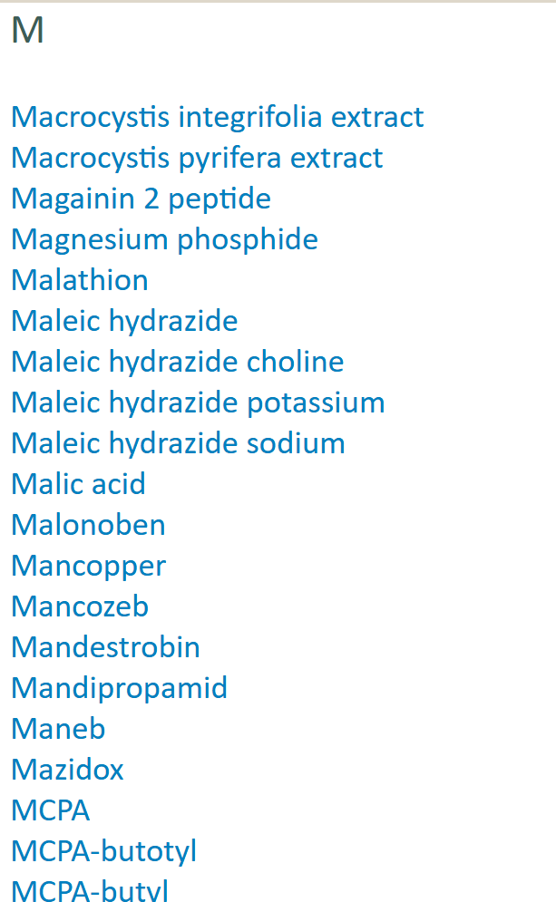
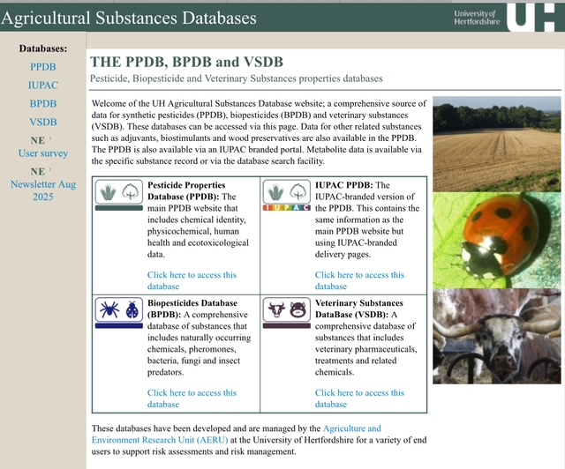
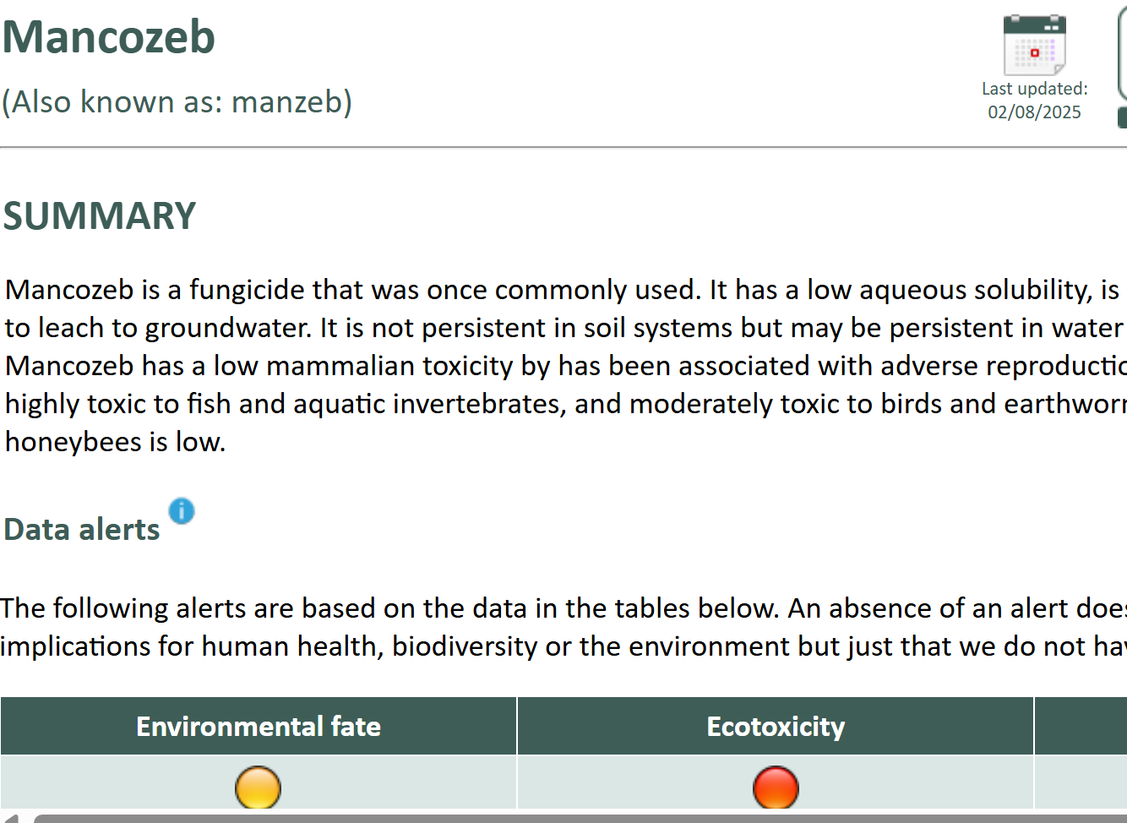
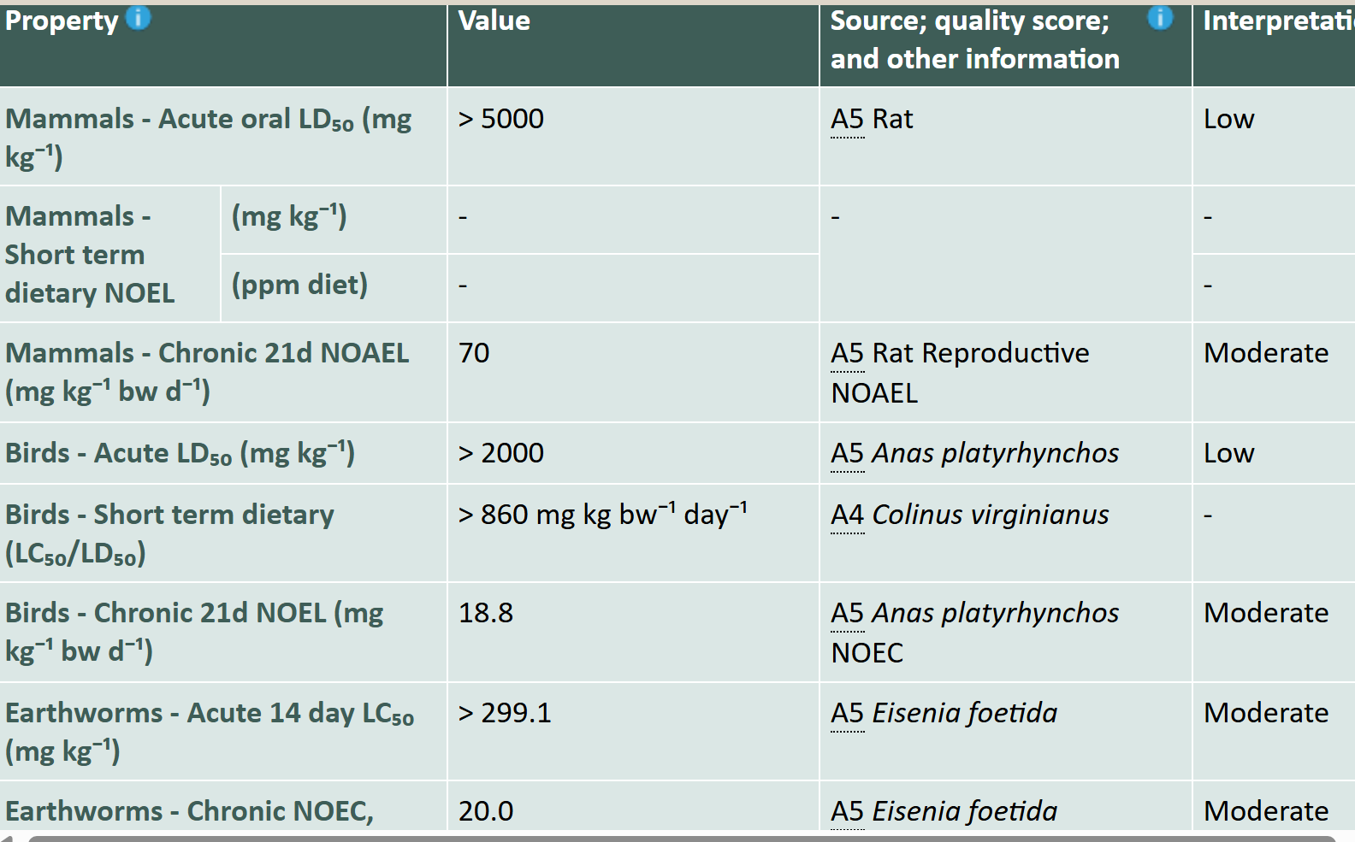
PPDB home page
Screen shots of the online system.
Snippit of the
PPDB A-Z index.
Pesticide profile pages.
Database home page

Slide 15
Data sources and choices
04
Firstly, we define each data parameter in terms of meta-data. For physico-chemical and environmental fate data this might be in terms of, for example, measurement conditions and reporting metrics. For ecotoxicity it is in terms of the tested species, toxicological end point and reporting metric.
This data is then collated from a variety of sources. Our preferred source is regulatory data preferably from the EU, UK, US, Canada Health or similar nation. Failing that we will search peer-reviewed literature, manufacturers, other databases and online resources. If we cannot locate our exact defined data type we will look for a close alternative. This might mean for example, data at a non-standard temperature, a different species or different toxicological endpoint.
The result is that our datasets are as complete as they can be, but they are not ‘pure’ – meaning that the data type may not be identical for each pesticide. This information is communicated to the user via an associated text description and our unique Quality Barometer (QB). The QB is a two-part code which conveys the broad data source type and our confidence in the data quality. Data quality is allocated via a simple rule-base assigning a number 0-5 (low-high).

Slide 16
Data management
04
The core database has been developed in an off-line MS Access format. This database consists of 20+ tables and hundreds of parameters.
To aid data management, a bespoke Data Management Software system has been developed in-house which allows data to edited, added, searched and displayed off-line. It also allows us to keep tract of updates, data sources and other management data.
Data is updated regularly using our data protocols. These describe each parameter, its meta data and preferred reporting format. This helps ensure data integrity and uniform data presentation.
The Data Management System validates data entry, checks for erroneous entries and ensures embedded links function. It calculates indices, the data alerts and applies the interpretation rules. It then automatically writes the hundreds of HTML pages for the PPDB website.
The Data Management system can also export data selected from the core database for external clients in MS Access or MS Excel files.
The next slide provides a schematic of the data management system.

Slide 17





CORE PPDB
Management software checks the data, external links and writes static HTML pages for uploading to the public free-to-use PPDB website.
Data collated from scientific publications, regulatory documents & databases. Data is reformatted, interpreted & used to populate the core PPDB.
PPDB Core system is a MS Access database.
Data is stored, updated and maintained off-line using AERU-UH in-house developed management software.
Data exports to MS Access or MS Excel sold under time-limited licences to UH external clients. Data also used by AERU to support research contracts.
Data management protocols & data quality assessments ensure data integrity. Data is updated regularly.

Slide 18
Behind the scenes
Our collaborators
We collaborate with various organisations. This enables us to offer additional data and facilities on the website. For example, the 3D chemical structure diagrams are provided by the Cambridge Crystallographic Data Centre. We also have good working relationships with the pesticide industry who provide data and help validate our data sets.
Art of presentation
We try to present our data in a logical and structured manner. Our clients are varied from laypersons to risk assessment professionals and regulators. The pesticide profile pages include data interpretations, pop-up windows to provide additional information and help icons for understanding the data.
Tracking usage
Whilst our online users do not need login names or accounts to use the PPDB, we do have a data tracker which helps us keep track of the broad user location and how they access and use the data. It also tells us the most population pages and when our documents are downloaded.

Slide 19
BPDB, VSDB & Other substances
05
Biopesticides
Same structure as PPDB.
Includes plant- & insect-derived chemicals, pheromones, beneficial bacteria and virus’s, micro- and macro-organisms.
Some additional data.
Separate web-pages and substance index.
Veterinary
Same structure as PPDB.
Stores data for veterinary pharmaceuticals.
Some additional data.
Some additional data sources.
Separate web-pages and substance index.
Other substances
Same structure as PPDB.
Stores data for biostimulants, synergists, safeners, adjuvants, wood preservatives, bactericides & other biocides.
Some additional data sources.
Included as a sub-index to the PPDB.

Slide 20
User support facilities
06
Various user support facilities are available on the website including:
A search facility which allows specific pesticides to be identified by various names, codes and identifiers.
Each database has a main A-Z index to help identify specific substances quickly.
There are a number of useful documents on the website giving detailed information on the databases and how they should be used.
Other documents are also available including newsletters, posters, presentations, videos and associated publications.
Licensing details and fees.
Error reporting form.
You can print out individual records for reference.
Or email us – aeru@herts.ac.uk

Slide 21

Hints and tips
07
Can’t find a pesticide in our system? Pesticides are often known by many different names. Use the search facility which works using chemical names, common names, synonyms and the CAS number.
Metabolites are best found using the link from the parent page.
Pesticide data, especially that for ecotoxicity. is notoriously variable. Different data from different sources doesn’t necessarily mean one is wrong. It might just be from a different study. We try and give the worse case data for ecotoxicity.
Our data records are rarely complete for a number of reasons. The data might not exist, we might not have found it or we may have rejected it. We don’t guarantee we have all the data or that our data is error-free. Talk to us if something is missing or doesn’t look right.
Remember our data sets are not ‘pure’ and so it’s important to take careful note of the supporting associated text fields.
Remember data is not fixed. It can and does change regularly as new data emerges and risk assessments evolve. Data on the website is the most up to date. Data issued under licence as Access or Excel are snapshots of the data on the issue date. It might contain different data to that online.

Slide 22
Licensing, T&Cs and services
08
Data on our websites are free to use subject to compliance with our Copyright and Terms and Conditions of Use.
Data is issued as MS Access and MS Excel subjected to payment of a fee for a time-limited licence.
The fee is based on the amount of data required, what you intend to use the data for and how many people will access the data. Discounts are given for multi-year licences. Full information can be found on the PPDB website.
We can create bespoke data sets for you.
We can develop datasets for you.
We will consider adding your data to our system for public dissemination – talk to us.

Slide 23
Example applications
09
Policy & monitoring
Development evidence-based pesticide policies.
Policy support for food and water companies.
Development of water quality monitoring programmes.
Screening studies.
Research
Development of risk assessment models and similar tools.
Chemical discovery applications.
In silico property predictions
Exposure mapping
Risk assessments
Data sets for models and decision support systems
Indicator development
AI applications
Grower exposure assessments.
Species specific studies (e.g. bees, beneficial arthropods)

Slide 24
PPDB & Pesticide Indicators
09
UK Pesticide Load Indicator (PLI): The UK PLI consists of 20 load metrics: 4 environmental fate metrics (incl. persistence and mobility) and 16 ecotoxicity metrics (incl. toxicity to non-target wildlife species) from the PPDB. These metrics are combined with estimates of the mass of application (based on the UK PUS) to examine patterns in load across space and time. The PLI is being used to support a national target to reduce pesticide load by at least 10% by 2030, using 2018 as a baseline year (as outlined in the UK Pesticides National Action Plan 2025). The work is funded by the Defra and undertaken in collaboration with Fera Science.
Pesticide risk indicator for the Convention on Biological Diversity: The PPDB team are contributing to an expert group convened by the FAO to help develop a methodology for Headline indicator 7.2 under the monitoring framework of the Kunming-Montreal Global Biodiversity Framework (GBF)..
FEAST: The Farmland Ecosystem Assessment Support Tool (FEAST) software (developed by AERU as part of their H2020 FrameWORK project) has been adapted to include the metrics within the UK PLI and GBF to facilitate the calculation of farm level pesticide load.

Slide 25
Contact details
10
Do you have any questions?
For licensing & purchasing email Dr Andy Green: a.green@herts.ac.uk
For website, technical, and other issues email: aeru@herts.ac.uk

Slide 26
Thanks
CREDITS: This presentation template was created by Slidesgo, and includes icons by Flaticon, and infographics & images by Freepik
August 2025

